Slide 1




Notes:
*

Slide 2


UI ENGINEERING STUDIO
UI Engineering Studio. Day 6 Bootcamp: JS Functions

Slide 3


UI ENGINEERING STUDIO
Declaring Functions
Functions
Functions are one of the fundamental building blocks in JavaScript. A function is a JavaScript procedure—a set of statements that performs a task or calculates a value. To use a function, you must define it somewhere in the scope from which you wish to call it.
-MDN
First Class Functions
Function Arguments
Closures
Anonymous Functions

Slide 4
UI ENGINEERING STUDIO
Function declaration
UI Boot Camp: JS Declaring Functions
function sumar(a, b) {
return a + b;
}
A function definition (also called a function declaration, or function statement) consists of the function keyword, followed by:
The name of the function.
A list of parameters to the function, enclosed in parentheses and separated by commas.
The JavaScript statements that define the function, enclosed in curly brackets, { }.
-MDN
Function expression
var restar = function(a, b) {
return a - b;
}

Slide 5
UI ENGINEERING STUDIO
UI Boot Camp: JS
First-class Function
A programming language is said to have First-class functions when functions in that language are treated like any other variable. For example, in such a language, a function can be passed as an argument to other functions, can be returned by another function and can be assigned as a value to a variable.
var restarInvert = function(a, b) {
return b - a;
}
function resta(a, b, restar) {
return restar ? restar(a,b) : a - b;
}
resta(1, 2);

Slide 6
UI ENGINEERING STUDIO
UI Boot Camp: JS Functions
Parameters
Function with parameters
Variable parameter number
function sumar(a, b) {
return a + b;
}
function sumar(a, b, ...rest) {
return rest[0];
}
Function without parameters
Default values for parameters
function procedure() {
// ...
}
function sumar(a, b, c = 0) {
return a + b + c;
}

Slide 7
UI ENGINEERING STUDIO
UI Boot Camp: Basics JS Functions
Scope
// example 1
function add5(otherNumber) {
var five = 5;
return otherNumber + five;
}
console.log(add5(7)); // 12
console.log(five); // undefined
Variables defined inside a function cannot be accessed from anywhere outside the function, because the variable is defined only in the scope of the function. However, a function can access all variables and functions defined inside the scope in which it is defined.
-MDN
// example 2
var five = 5;
function add5(otherNumber) {
return otherNumber + five;
}
console.log(add5(7)); // 12
console.log(five); // 5
Notes:
Null check, default default. foo && foo.baz
Counter example

Slide 8
UI ENGINEERING STUDIO
UI Boot Camp: Basics JS Closures
var x = 10;
function foo() {
var y = 20;
function bar() {
var z = 15;
return x + y + z;
}
return bar();
}
console.log(foo()); // 45
JavaScript allows for the nesting of functions and grants the inner function full access to all the variables and functions defined inside the outer function (and all other variables and functions that the outer function has access to). However, the outer function does not have access to the variables and functions defined inside the inner function.

Slide 9
UI ENGINEERING STUDIO
UI Boot Camp: Basics JS
Anonymous functions
var list = [1, 2, 3, 4];
var total =
list.reduce(function(total, number) {
return total + number
}, 0);
console.log(total) // 10
Anonymous functions are functions without a name. Usually used in function expressions or when using the callback pattern

Slide 10
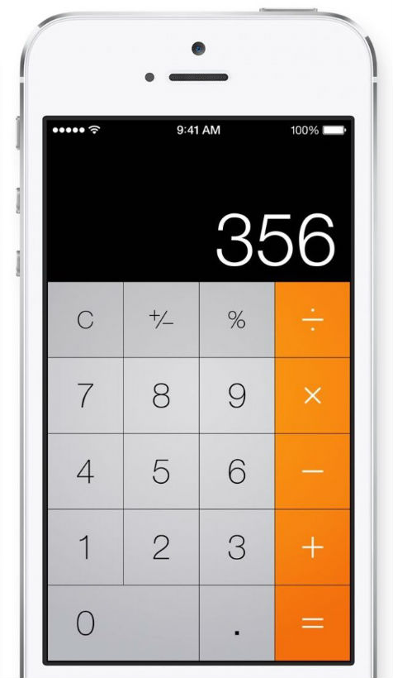
UI ENGINEERING STUDIO
UI Boot Camp: HTML Homework: Calculator
https://www.sitepoint.com/dom-manipulation-vanilla-javascript-no-jquery/

Slide 11
Notes:
*

